Slide 1



DNA 17 Tutorial:
Theory of Algorithmic Self-Assembly with DNA Tiles
Dave Doty
California Institute of Technology

Slide 2
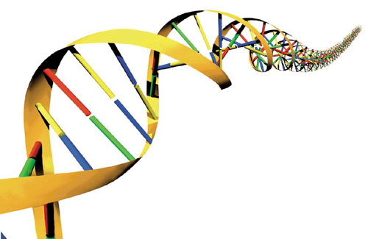
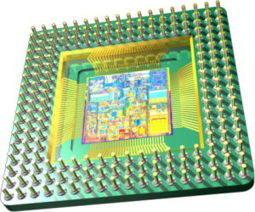
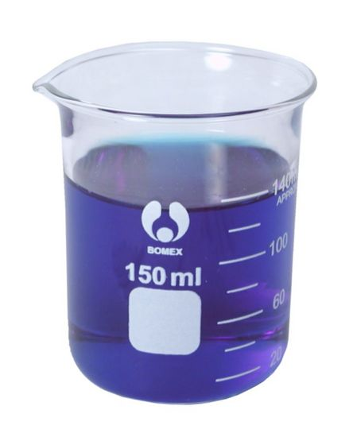
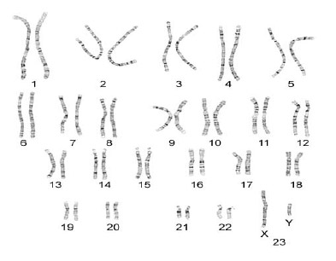

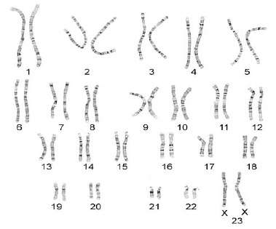

Molecular Self-Assembly
Engineering Goal
Nature's Proof of Concept
Notes:
Designing molecules to automatically assemble a target structure
Manipulation of molecules by hand is often impossible
We must program molecules to manipulate themselves

Slide 3
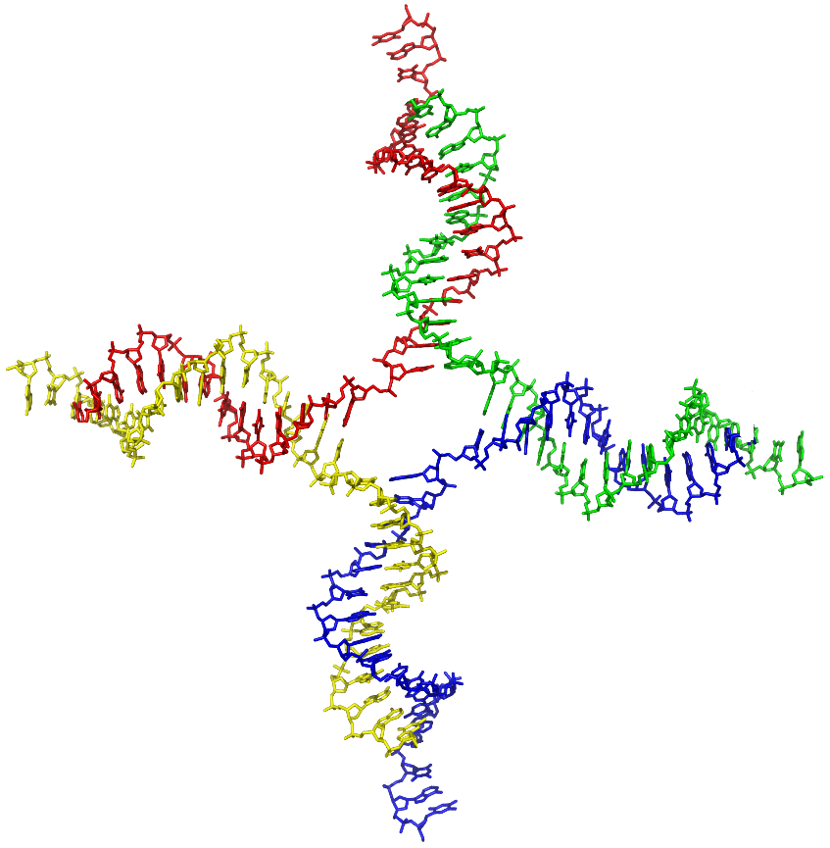
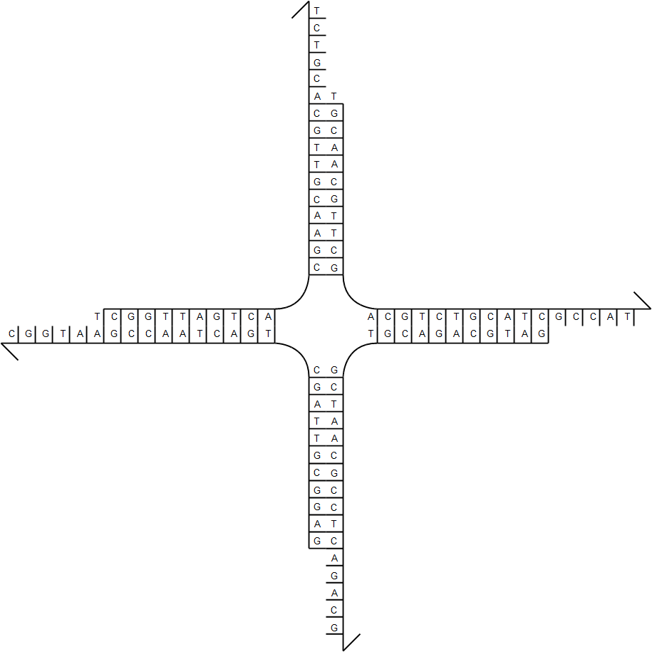
Practice of DNA Tile Self-Assembly
DNA tile (branched junction, Seeman, Journal of Theoretical Biology 1982)
sticky end
Source:en.wikipedia; Author: Zephyris at en.wikipedia; Permission: PDB; Released under the GNU Free Documentation License.

Slide 4
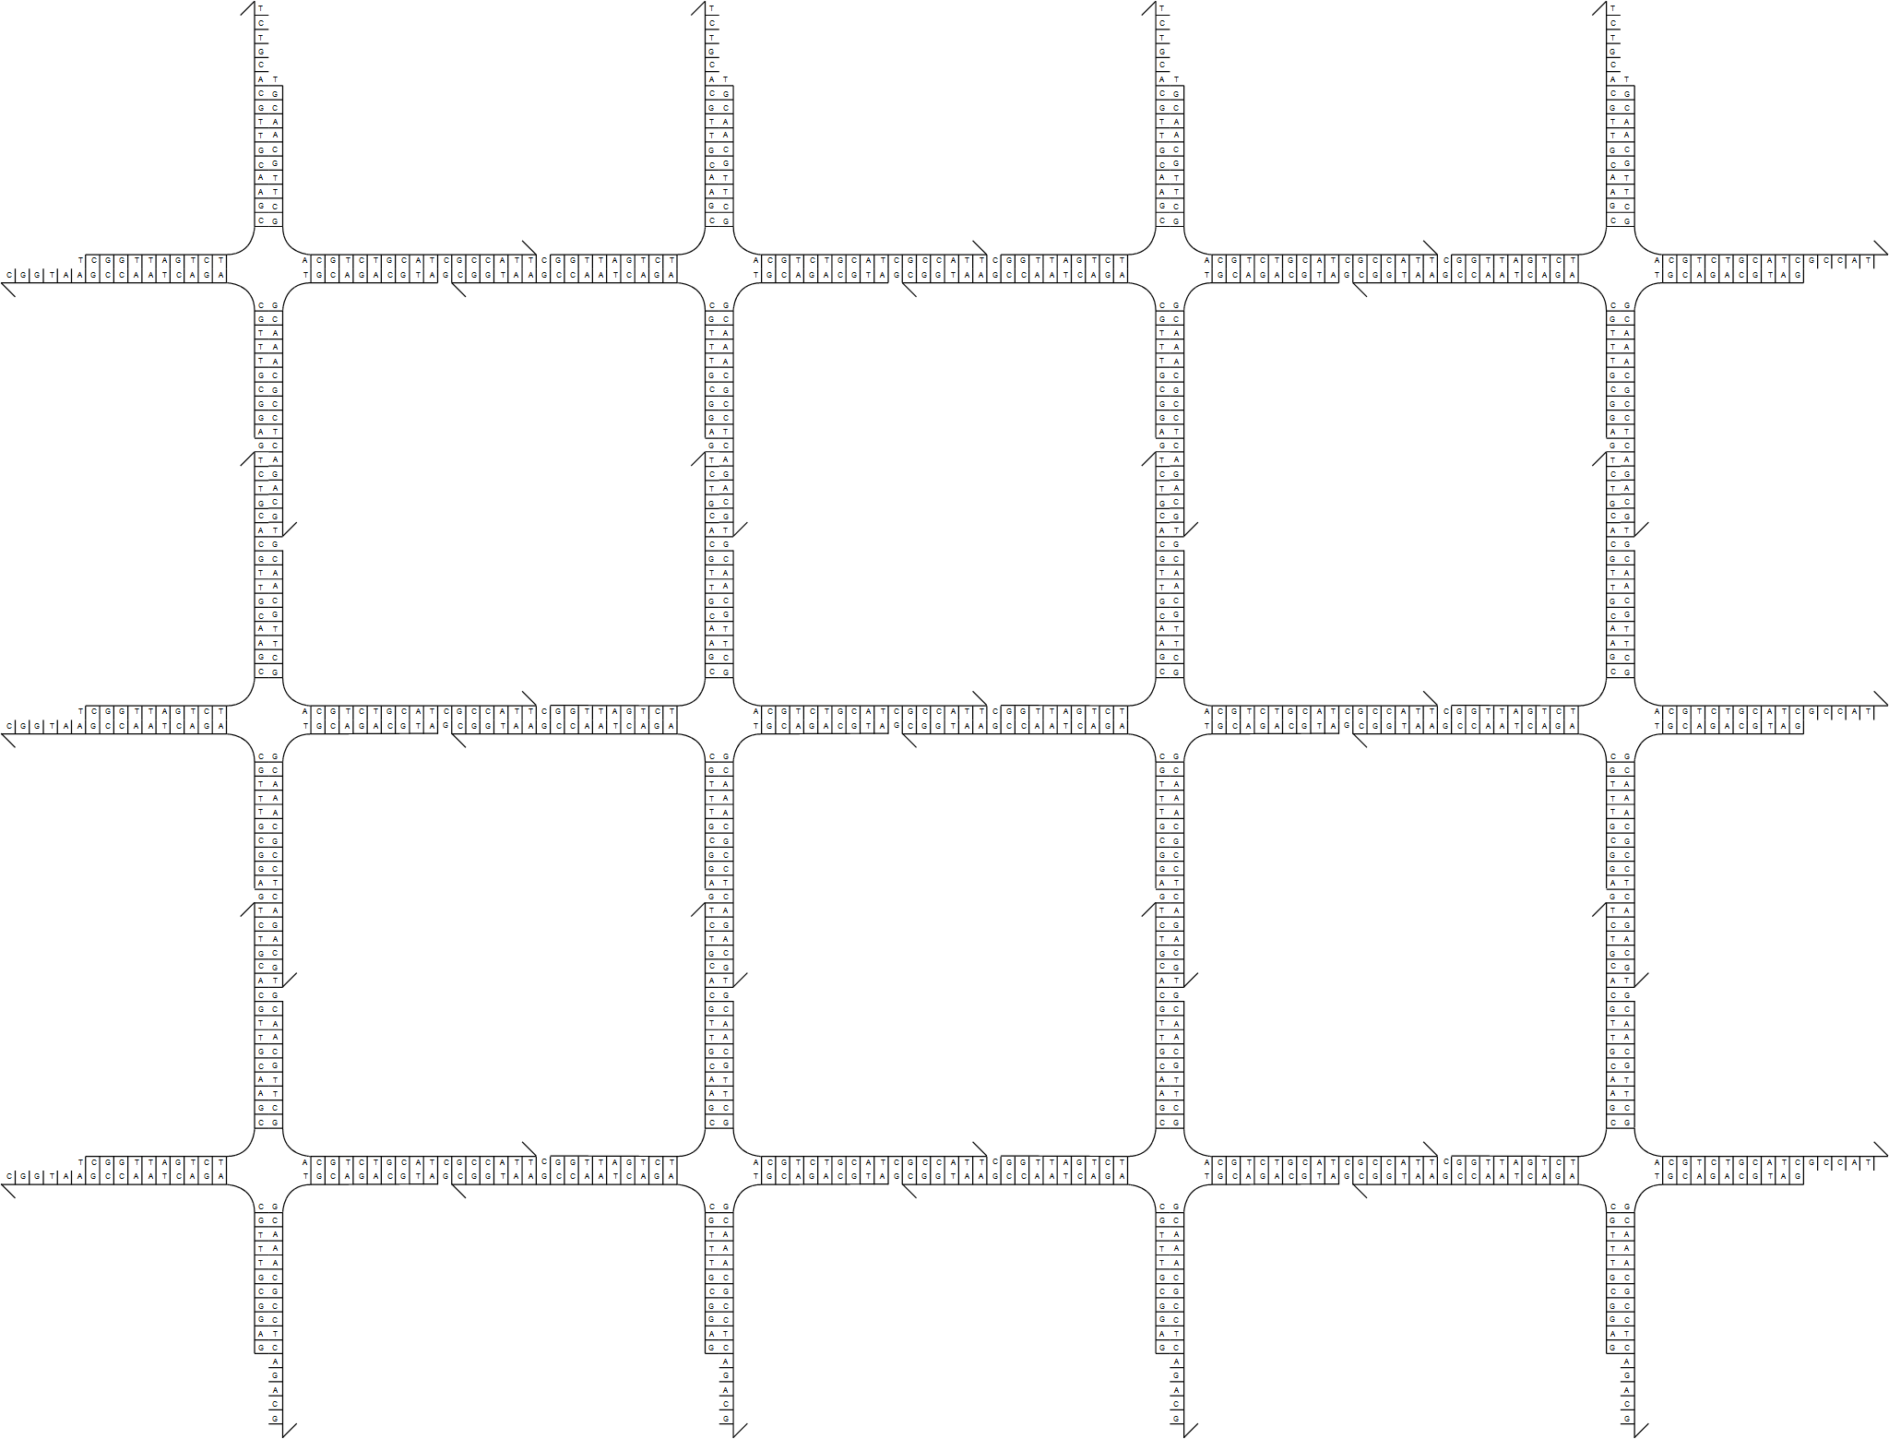
Practice of DNA Tile Self-Assembly
Place many copies of DNA tile in solution...

Slide 5
Practice of DNA Tile Self-Assembly
What really happens (“helical stacking”) ...
or

Slide 6
Practice of DNA Tile Self-Assembly
If all tiles take the same orientation, changes shape of grid but not connectivity
How to ensure that all tiles take the same orientation?

Slide 7


Practice of DNA Tile Self-Assembly
Double-crossover tile (Fu, Seeman, Biochemistry 1993)
single crossover between helices
two crossovers between helices
Figure taken from Winfree, Liu, Wenzler, Seeman, Nature 1998
Figure taken from Schulman, Winfree, PNAS 2007

Slide 8
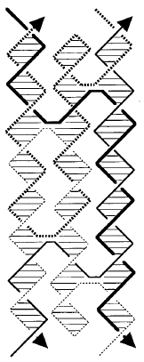
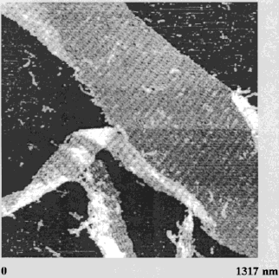
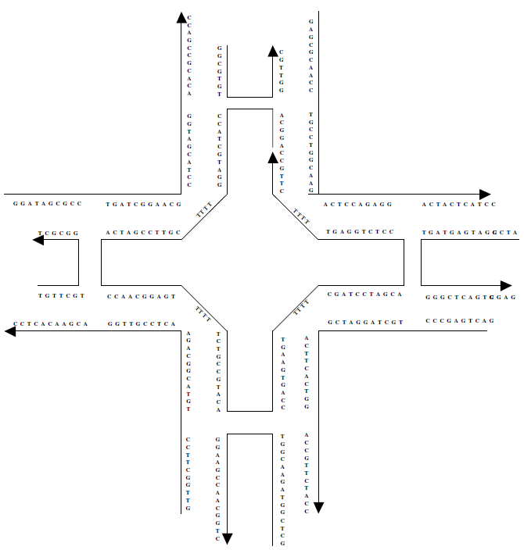
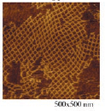

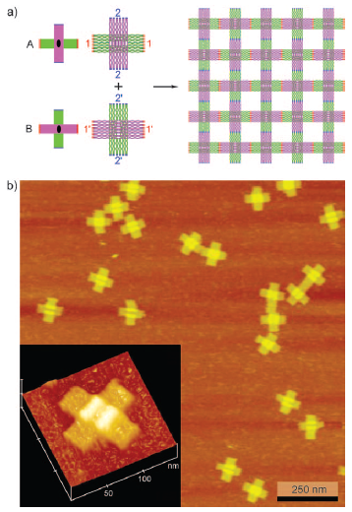
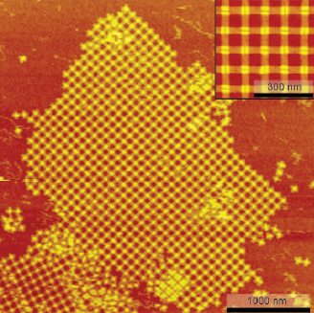
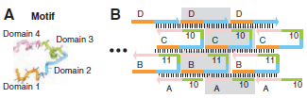
Practice of DNA Tile Self-Assembly
Some other tile motifs
4x4 tile (Yan, Park, Finkelstein, Reif, LaBean, Science 2003)
triple-crossover tile (LaBean, Yan, Kopatsch, Liu, Winfree, Reif, Seeman, JACS 2000)
single-stranded tile (Yin, Hariadi, Sahu, Choi, Park, LaBean, Reif, Science 2008)
DNA origami tile (Liu, Zhong, Wang, Seeman, Angewandte Chemie 2011)

Slide 9
Theory of Algorithmic Self-Assembly
Erik Winfree asked, “What if ...”
  … there is more than one type of tile, with different sticky ends?
  … some sticky ends are “weak”? (cooperative binding: two sticky ends required to attach tile)
Cooperation enables algorithmic behavior.

Slide 10
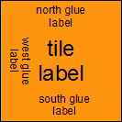
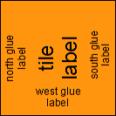
Abstract Tile Assembly Model
[Winfree, Ph.D. Thesis 1998]
tile type = unit square
each side has a glue, with a label and a strength (0,1,2)
if tiles with matching glues touch, they are attracted with the glue's strength
tiles cannot be rotated
finitely many tile types
infinitely many tiles: copies of each tile type
assembly starts as a single copy of a special seed tile type
a tile can attach to the assembly if it binds with total strength at least 2 (the “temperature”)
strength 0
strength 1
strength 2

Slide 11
Temperature 2 tile set
finite set of tile types:
seed
N
0
W
XOR
0
1
1
1
Cooperation: these two tiles must be present before this tile can bind
N
1
1
W
W
1
N
1
1
1
XOR
0
1
XOR
1
Tile computes a function
1
0
N
1
N
0
1
1
N
0
1
N
0
0
1
1
1
seed
W
W
W
W
W
N
0
XOR
0
0
XOR
1
W
W
0
1

Slide 12
Temperature 2 tile set
finite set of tile types:
0
0
0
0
0
1
1
0
0
1
1
N
0
0
0
0
0
0
0
0
0
1
1
1
1
0
0
0
0
1
1
1
seed
0
0
0
0
1
0
1
0
1
0
N
N
0
0
0
0
1
0
1
0
1
0
N
W
0
0
0
0
0
0
0
1
1
0
0
1
1
0
0
1
1
0
0
1
1
N
0
0
0
1
1
1
1
1
1
1
0
0
0
1
1
1
1
1
1
1
1
N
0
0
0
0
0
0
0
1
1
1
0
1
1
0
1
1
0
1
1
0
1
1
0
1
1
0
1
1
0
1
N
0
0
1
0
0
0
0
0
0
0
1
N
0
0
0
0
1
1
1
1
0
0
0
0
0
0
0
0
0
0
0
0
0
0
0
0
0
0
0
0
1
1
N
N
1
0
1
1
0
0
0
0
0
0
1
1
N
1
W
W
0
1
1
1
0
1
1
1
0
0
0
0
0
0
0
0
0
0
0
0
0
0
0
0
0
1
1
1
0
1
N
N
1
0
1
0
0
0
0
0
1
0
1
N
1
1
0
0
1
1
1
1
0
0
0
0
0
0
0
0
0
0
0
0
0
0
1
1
1
1
0
0
1
1
N
1
1
1
0
0
0
0
1
1
1
1
N
1
0
1
1
0
1
1
1
0
0
0
0
0
0
0
0
0
0
0
1
1
1
0
1
1
0
1
1
0
1
N
1
1
0
0
1
0
0
0
1
0
0
0
1
N
1
XOR
0
1
XOR
1
0
0
0
0
1
1
1
1
0
0
0
0
0
0
0
0
1
1
1
1
0
0
0
0
0
0
0
0
1
1
N
1
0
0
1
1
0
0
1
1
0
0
1
1
N
0
1
1
1
0
1
1
1
0
0
0
0
0
1
1
1
0
1
1
1
0
0
0
0
0
1
1
1
0
1
N
1
0
1
0
1
0
1
0
1
0
1
N
0
1
1
1
1
0
0
1
1
1
1
0
0
1
1
1
1
0
0
1
1
0
1
1
1
1
0
0
1
1
N
0
0
1
1
1
seed
1
1
N
1
1
1
1
1
W
1
W
0
XOR
0
0
XOR
1
W
W
W
W
W
W
W
W
W
W
W
W
W
W
W
W
W
W
W
W
W
0
1

Slide 13
Another temperature 2 tile set
finite set of tile types:
0
N
0
0
0
0
0
0
0
0
0
1
0
1
1
0
0
0
1
1
0
0
1
N
0
0
0
0
0
0
0
1
0
1
0
0
0
0
0
1
1
1
0
1
1
0
0
0
0
0
0
0
0
0
1
0
1
0
0
0
0
0
1
0
1
N
0
0
0
0
0
0
0
0
1
0
0
1
1
0
0
0
1
1
0
N
0
N
0
0
0
0
0
0
0
1
0
0
0
1
1
0
0
1
0
0
0
1
1
N
0
0
0
0
0
1
0
0
0
1
0
0
0
1
0
0
0
1
0
1
1
0
0
0
0
0
0
0
1
0
0
0
1
0
0
0
1
0
0
0
0
N
0
0
0
0
0
0
1
0
1
0
1
1
1
0
1
0
1
0
1
N
0
N
0
0
0
0
0
1
0
1
0
1
0
1
1
1
0
1
0
1
0
0
1
N
0
0
0
1
0
1
0
1
0
1
0
1
1
1
1
1
1
1
0
1
0
0
0
0
0
1
0
1
0
1
0
1
0
1
1
1
1
1
0
1
1
N
0
0
0
0
1
0
0
0
0
0
0
0
0
1
0
1
0
1
0
N
0
N
0
0
0
1
0
0
0
0
0
0
0
0
0
0
1
0
1
0
0
1
1
N
0
1
0
0
0
0
0
0
0
0
0
0
0
0
0
0
0
1
0
1
1
0
0
0
1
0
0
0
0
0
0
0
0
0
0
0
0
0
0
0
0
N
0
0
1
0
1
0
0
0
0
0
0
0
0
1
0
1
0
0
1
N
0
N
0
1
0
1
0
0
0
0
0
0
0
0
0
0
1
0
1
1
1
0
1
N
0
1
0
0
0
0
0
0
0
0
0
0
0
0
0
1
1
1
0
1
1
0
1
0
1
0
0
0
0
0
0
0
0
0
0
0
0
0
1
0
1
N
1
0
0
0
1
0
0
0
0
0
0
0
0
1
0
0
1
1
0
N
1
N
0
0
0
1
0
0
0
0
0
0
0
0
0
0
1
1
0
0
0
1
1
N
0
1
0
0
0
0
0
0
0
0
0
0
0
1
0
0
0
1
1
1
1
0
0
0
1
0
0
0
0
0
0
0
0
0
0
0
1
0
0
0
0
N
1
0
1
0
1
0
0
0
0
0
0
0
0
1
1
0
1
0
1
N
1
N
0
1
0
1
0
0
0
0
0
0
0
0
0
1
1
1
0
1
1
0
1
N
0
1
0
0
0
0
0
0
0
0
0
1
0
1
1
1
1
1
1
1
1
0
1
0
1
0
0
0
0
0
0
0
0
0
1
0
1
1
1
0
1
N
1
1
0
0
0
0
1
0
0
0
0
0
0
0
1
0
0
1
0
1
0
N
Σ
0
N
0
0
0
1
0
0
0
0
0
0
0
1
0
0
0
0
1
0
0
1
1
N
0
c
HA
0
0
1
0
1
0
0
0
0
0
0
0
1
0
0
0
0
0
0
0
1
0
1
1
0
0
0
1
0
0
0
0
0
0
0
1
0
0
0
0
0
0
0
0
N
0
0
1
0
1
0
0
0
0
0
1
0
1
0
0
1
0
0
1
N
1
0
0
N
0
1
0
1
0
0
0
0
0
1
0
1
0
0
0
0
1
1
1
0
1
N
0
1
0
0
0
0
0
1
0
1
0
0
0
0
0
1
1
1
0
1
1
0
1
0
1
0
0
0
0
0
1
0
1
0
0
0
0
0
1
0
1
N
1
0
0
0
1
0
0
0
1
0
0
0
1
0
0
0
1
1
0
N
N
1
N
0
0
0
1
0
0
0
1
0
0
0
1
0
0
0
1
0
0
1
1
1
1
0
0
0
1
0
0
0
1
0
0
0
1
0
1
0
0
0
1
0
0
1
0
1
0
0
0
1
0
0
0
1
0
0
0
0
0
1
0
0
1
N
0
0
0
N
1
0
1
0
1
0
1
0
1
0
1
0
1
0
1
0
1
0
1
1
1
seed
seed
N
1
1
N
1
1
0
1
0
1
0
1
0
1
0
0
0
0
0
W
0
W
0
0
1
1
W
W
W
W
W
W
W
W
W
W
W
W
W
W
W
W
W
W
W
W
W
W
W
W
W
W
W
W
W
W
W
W
W
W
W
W
W
W
W
W
W
W
0
1

Slide 14
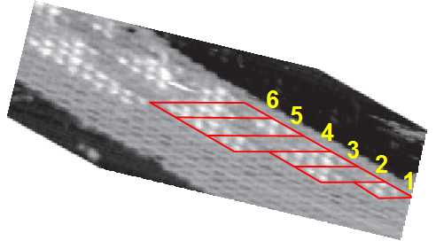
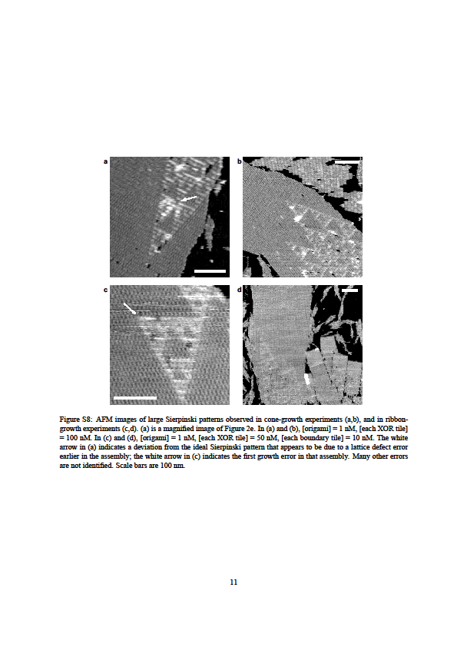
Algorithmic Self-Assembly in Action
Fujibayashi, Hariadi, Park, Winfree, Murata,
Nano Letters 2008
Copyright © National Academy of Sciences
Barish, Schulman, Rothemund, Winfree,
PNAS 2009
Copyright © American Chemical Society

Slide 15
Why "Algorithmic" Self-Assembly?
Set of tile types is like a program
Shape it creates, or pattern it "paints", is like the output of the program
tile set A:
tile set B:

Slide 16

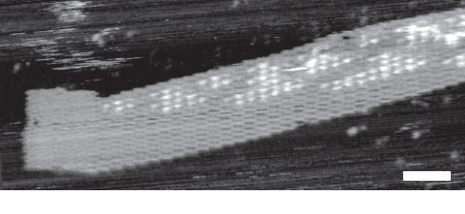
Algorithmic Self-Assembly
How is a set of tile types not like a program?
Where's the input to the program?
One idea: pre-made seed assembly
tile set A:
seed X:
seed Y:
seed Z: (DNA origami rectangle with sticky ends on right edge)
A(X)
A(Y)
A(Z)
DNA tiles
© Barish, Schulman, Rothemund, Winfree, PNAS 2009

Slide 17
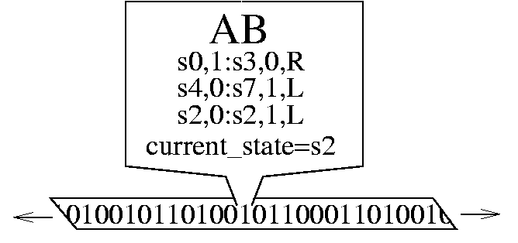
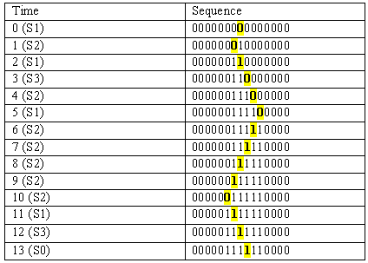
Turing Machines
space-time configuration transcript
source: infrastructures.org
source: MIT 6.004

Slide 18
(Some) Fundamental Theoretical Results in the aTAM
(in my humble opinion)

Slide 19
The aTAM is Turing Universal [Winfree, Ph.D. Thesis, 1998]
Informally: tiles can “simulate” any algorithm
Theorem:
  For every Turing machine M,
  there is a tile set T so that,
  for every input string x,
  there is a seed assembly σ of T so that ...
T with seed σ assembles a space-time configuration transcript of M on input x.
i.e., T ≈ program M, σ ≈ data x

Slide 20
Turing Machine Simulation
halt
s,0 → q,0,R
s,0 → q,0,R
q,0 → t,1,L
0
0
1
u 1
1
1
_
_
_
_
_
_
q,0 → t,1,L
u
u
q,1 → s,0,R
q,1 → s,0,R
0
0
t 0
1
1
1
_
_
_
_
_
t,0 → u,1,R
t
t
t,0 → u,1,R
u,1 → halt
u,1 → halt
0
0
0
q 0
1
1
_
_
_
_
q
q
0
0
s 0
0
1
1
_
_
_
s
s
0
q 1
0
0
1
1
_
_
q
q
s 0
1
0
0
1
1
_
time
cooperation to combine current state with current symbol
space

Slide 21
Tile Complexity
Given: a finite shape S
Question: What is the smallest (singly-seeded) tile set that assembles S?
4 distinct types of tiles

Slide 22
Tile Complexity
Tile complexity of single point: 1
Tile complexity of 1 x n line: n
Tile complexity of n x n square: ?
at least ≈ log n / log log n for “most” n [Rothemund, Winfree, STOC 2000]
at most ≈ log n / log log n for all n [Adleman, Cheng, Goel, Huang, STOC 2001]

Slide 23
Assembling an n x n (almost) square from ≈ log n tile types
carry in MSB → no north glue
0
0
0
0
1
1
1
1
...
1
0
0
1
1
0
0
0
1
0
0
0
copy
0
1
1
1
increment
0
1
1
1
0₃
1₂
1₁
0₀
≈ log n tiles

Slide 24
Tile Complexity of Arbitrary Shapes
Scaled shape S^{c}: S “magnified” by some scaling factor c
If we can't build this ...
... we'll settle for this.
factor 3
For every shape S, there is a scaling factor c so that some tile set of size ≈ K(S) assembles S^{c}, where K(S) is the size (in bits) of the smallest program that “prints” S. [Soloveichik, Winfree, SICOMP 2007]

Slide 25
Complexity of Computing Tile Complexity
How difficult is it to algorithmically answer the tile complexity question?
Given arbitrary shape S, computing tile complexity of S is NP-complete (i.e., no efficient algorithm for it).
  [Adleman, Cheng, Goel, Huang, Kempe, Moisset de Espanes, Rothemund, STOC 2002]
Given a tree shape S (only one path between any two points in S), finding tile complexity of S is efficiently computable.
  [same paper]

Slide 26
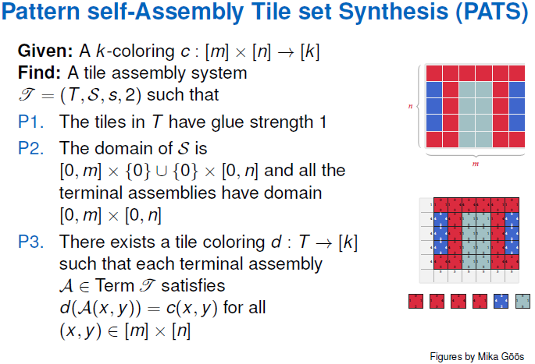
Complexity of Computing Tile Complexity at DNA 17
[Lempiäinen, Czeizler, Orponen, DNA 17]

Slide 27
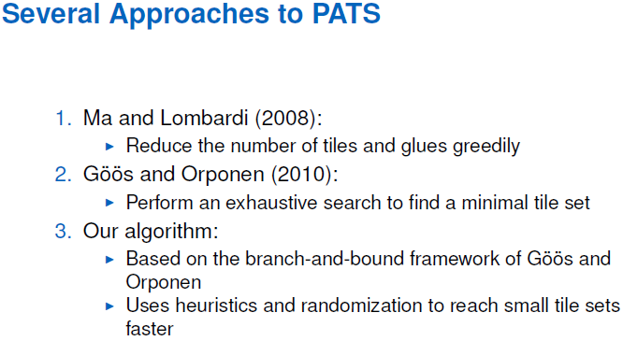
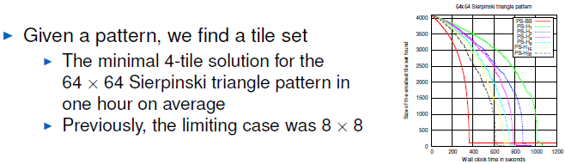

Slide 28
Assembly Time
Basic Time Model:
  expected time for tile t to attach to an empty location is proportional to 1/[t] : concentration of t
  concentration of each tile type held constant (valid if seed is much lower concentration)
  concentrations of all tile types must sum to ≤ 1
Parallelism allowed: if many empty binding locations, could all bind in short time

Slide 29
Parallelism
potential attachment location
attached tile
time step 0

Slide 30
Parallelism
potential attachment location
attached tile
time step 1

Slide 31
Parallelism
potential attachment location
attached tile
time step 2

Slide 32
Parallelism
potential attachment location
attached tile
time step 3

Slide 33
Parallelism
potential attachment location
attached tile
time step 4
time t: perimeter ≤ t (with high probability)
→ max attachments per time step ≤ t
→ max total attachments after t steps ≤ t²
→ min time to assemble any shape of size N ≥ √N

Slide 34
Assembly Time
Expected time to assemble any shape of diameter d is at least d. (diameter = largest distance between any two points)
  [Adleman, Cheng, Goel, Huang, STOC 2001]
Any n x n square can be assembled in expected time ≈ n.
  [Adleman, Cheng, Goel, Huang, STOC 2001]

Slide 35
Power of Cooperative Binding
“Temperature 1” self-assembly: any tile may bind if even one glue matches

Slide 36
Power of Cooperative Binding
Turing machine simulation at temperature 1 in a certain nondeterministic sense [Adleman, Kari, Kari, Reishus, Sosik, FOCS 2002, SICOMP 2009]
Turing machine simulation at temperature 1 deterministically in 3D [Cook, Fu, Schweller, SODA 2011]

Slide 37
Power of Cooperative Binding
Computational power of deterministic 2D temperature 1 self-assembly is unknown.
Certain class of temperature 1 deterministic tile sets cannot do universal computation
  [D, Patitz, Summers, DNA 2009, TCS 2011]
Rothemund and Winfree [STOC 2000] conjectured temperature 1 tile complexity of assembling an n x n square is 2n-1
  True if no glue mismatches [Manuch, Stacho, Stoll, iCBBE 2009]

Slide 38
Modeling Errors
in Tile Assembly

Slide 39
Errors
ideal cooperative binding: tile attaches to assembly if and only if it interacts with strength ≥ 2 (such as two matching strength-1 glues)
a
c
stable at
temperature 2
c
stable at
temperature 2
b
d
a
a
a
b
c
a
a
b
c
c
d
b
d
b
d
b
d
unstable at
temperature 2
a
c
a
b
c
x
a
x
c
a
a
a
x
c
a
b
d
b
d
b
d

Slide 40
Errors
more realistic kinetic model: tile attaches to assembly but detaches "quickly" if attached with only strength 1 (and detaches "slowly" if attached with strength 2)
stable at
temperature 1 = temporarily stable at temperature 2
stable at temperature 2 but not producible at temperature 2
a
x
c
c
d
a
a
a
x
c
a
a
x
c
c
d
b
d
b
d
b
d
insufficient attachment...
becomes stabilized by subsequent attachment: permanent error!

Slide 41
Errors
aTAM makes (≥) two simplifying assumptions observed not to hold in practice:
  tiles never detach
  tiles only attach if held with strength 2
Using stochastic chemical kinetics to determine rates of attachment and detachment, gives the kinetic Tile Assembly Model (kTAM)

Slide 42
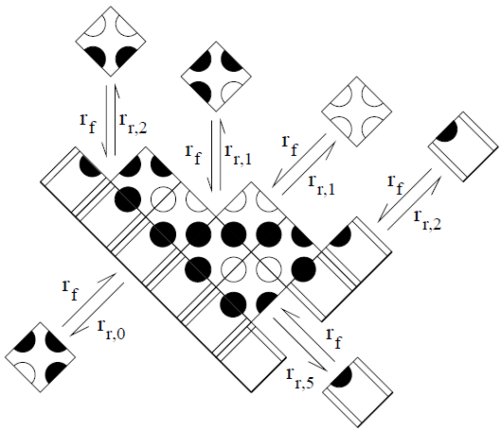
kTAM [Winfree, Ph.D. thesis 1998]
attachment rate of tile type t to empty position =
r_{f} ≈ [t] ≈ e^{–Gmc},
Gmc = entropy loss of binding
detachment rate =
r_{r,b} ≈ e^{–b∙Gse},
b = total binding strength
Gse = energy of single strength bond

Slide 43
kTAM can approximate aTAM [Winfree, Ph.D. thesis 1998]
By setting Gmc ≈ 2Gse, forward rate is just barely larger than reverse rate of strength 2 attachments
Assembly proceeds very slowly (more slowly the closer Gmc is to 2Gse), but high likelihood of only “correct” attachments in the end (more likely the closer Gmc is to 2Gse)

Slide 44
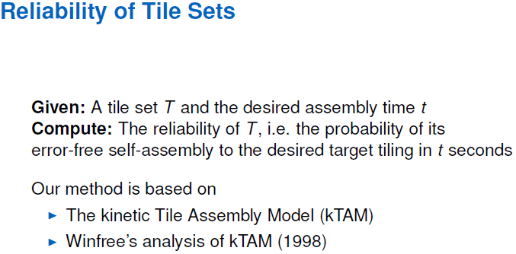
kTAM analysis at DNA 17
[Lempiäinen, Czeizler, Orponen, DNA 17]

Slide 45
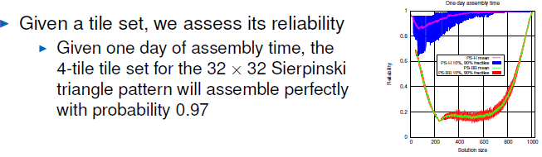
kTAM analysis at DNA 17
[Lempiäinen, Czeizler, Orponen, DNA 17]
Big picture: smaller tile set to assemble a pattern → more reliable tile set, and even same-size tile sets are more reliable when output by their program

Slide 46
Proofreading
Proofreading [Winfree, Bekbolatov, DNA 9]: force errors to come in groups; i.e. cannot have one insufficient attachment without forcing more to happen
block replacement scheme
n1
n2
T
w2
Tb
Tb
e2
n
w
e
Ta
Tc
s
Ta
Tc
w1
Td
Td
e1
s1
s2

Slide 47
Proofreading
Compact proofreading [Reif, Sahu, Yin, DNA 10]:
  no block replacement: each tile in original tile set represented by single tile in proofreading tile set
  exponential blowup in tile complexity except for a restricted class of tile sets (Soloveichik, Winfree, DNA 11)
Both standard and compact correct growth errors but not facet errors
y1
y1
W
Z
x3
x1
x2
x3
x4

Slide 48
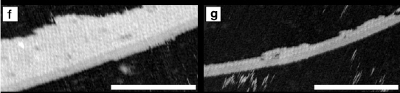
Proofreading
Snaked proofreading [Chen, Goel, DNA 10]: block replacement scheme that corrects both growth errors and facet errors
[Chen, Schulman, Goel, Winfree, Nano Letters 2007]
standard proofreading
snaked proofreading

Slide 49
Proofreading
Snaked proofreading [Chen, Goel, DNA 10]: block replacement scheme that corrects both growth errors and facet errors
y4
y
y3
x
y
y2
x
y1
y1
W
Z
x3
x1
x2
x3
x4

Slide 50
Self-Healing
Self-Healing [Winfree 2006]: transform a tile set to one that can re-grow correctly after large holes are cut out of the assembly
  a salamander that can regrow his severed tail
Extreme Self-Healing [Chen, Goel, Luhrs, Winfree, DNA 13]: there is a tile set of cardinality log n that assembles an n x n square from any subassembly of size ≥ 2 log n
  a salamander that can regrow the rest of his body from his severed tail (or his foot, or his ear)
Self-healing + Proofreading [Soloveichik, Cook, Winfree, Natural Computing 2008]

Slide 51
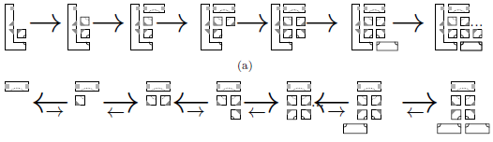
Nucleation Errors
What if aggregation happens away from the seed?
Kinetic Barrier to Unseeded Nucleation [Schulman, Winfree, DNA 10, SICOMP 2009, PNAS 2007]: class of tile sets (“zig-zag”) that can assemble quickly in the presence of a seed, but much more slowly without a seed

Slide 52
Fault-Tolerant Self-Assembly
Conclusion: under certain assumptions, the aTAM is an implementable “programming language” for tile self-assembly
All these results are algorithmic error correction: correction occurs via “software” within the kTAM
Other proposals include physical mechanisms that go around the kTAM to prevent spurious binding

Slide 53
Interesting Results in Variants of the aTAM

Slide 54
Nondiagonal Glue Strengths
aTAM assigns positive strength interaction only to equal glues
nondiagonal glue strengths allow positive strength between unequal glues
 | g1 | g2 | g3 | g4
g1 | 1 | 0 | 0 | 0
g2 |  | 2 | 0 | 0
g3 |  |  | 1 | 0
g4 |  |  |  | 1
 | g1 | g2 | g3 | g4
g1 | 1 | 0 | 1 | 0
g2 |  | 2 | 2 | 3
g3 |  |  | 1 | 0
g4 |  |  |  | 1

Slide 55
Tile Complexity with Nondiagonal Glue Strengths
Tile complexity lower bound of ≈ log n / log log n for assembling n x n square no longer holds
  Now it is ≈ √(log n)
For each n, there is a tile set with nondiagonal glue strengths, of optimal size √(log n), that assembles an n x n square
  [Aggarwal, Cheng, Goldwasser, Kao, Moisset de Espanes, and Schweller, SICOMP 2005]

Slide 56
Negative Glue Strengths
If glues are negative, tiles could fall off. (Oh no!) Not a bad thing: for example...
space-time configuration history of computation
0
1
1
0
1
1
0
0
1
0
0
1
1
0
1
1
0
1
1
0
0
1
1
0
1
1
0
1
1
0
Every Turing machine can be simulated by a tile set
time = t
0
1
1
0
1
1
0
1
1
0
0
1
1
0
1
1
0
1
0
0
1
1
0
1
1
0
1
0
1
1
0
1
1
0
1
0
1
1
0
1
0
0
1
space = s
size of assembly = s·t when space bound = s and time bound = t
"The difference between space and time is that you can reuse space but you can't reuse time." -- but not with this construction

Slide 57
Negative Glue Strengths
1
1
Could we use negative glues to completely break up "time n" row once "time n+1" row is complete?
1
0
1
1
0
0
0
1
1
0
1
0
0
1
time n row
time n+1 row
0
1
1
0
1
1
0
1
1
0
1
0
0
1
0
Then we could reuse ≈ s tiles (total number of molecules) for the entire computation.
By finite density constraint, this is necessary if volume ≈ s
1
0
0
1
1
0
1
1
0
1
1
1
0
1
1
0
0
1
0
time n+2 row
1
1
1
0
0
?
0
1
1
1
0
1
1
0
1
1
0
1

Slide 58
Negative Glue Strengths
[Reif, Sahu, Yin; DNA 2005]:
If attachment/detachment reactions are thermodynamically reversible, a set of ≈ s tiles can simulate an s-spaced-bounded Turing machine for arbitrarily many steps.
Assembly proceeds in an unbiased random walk, taking expected n² time to compute n steps.
[D, Kari, Masson, DNA 2010]:
Theorem 1: If reactions are irreversible, then after t steps of assembly, ≈ t tiles are permanently bound.
Theorem 2: With irreversible reactions, an s-space-bounded Turing machine can be simulated by a set of tile types, while ensuring no intermediate assembly grows larger than ≈ s
0
0
1
1
0
1
1
1
1
If t >> s, then size-s assembly of current configuration, but ...
0
0
1
0
0
1
1
1
1
1
0
0
1
1
0
1
0
1
0
1
1
0
1
1
0
0
1
0
0
1
0
by Theorem 1, there are t >> s unusable "junk" assemblies in solution
1
1
1
0
0
1
1
0
1
0
1
0
1
0
1
1
1
0
1
1
1
1
1
1
1
0
0
1
0
0
0
1
0

Slide 59
Negative Glue Strengths at DNA 17
[Patitz, Schweller, Summers, DNA 17]: Temperature 1 universal computation is possible with negative glue strengths
Nothing falls off; negative glues simply prevent incorrect tiles from binding.

Slide 60
Temperature Programming
[Aggarwal, Cheng, Goldwasser, Kao, Moisset de Espanes, and Schweller, SICOMP 2005]:
Vary temperature (binding strength threshold) throughout assembly to control what assembles.
temperature
time
singly-seeded set of tile types:

Slide 61
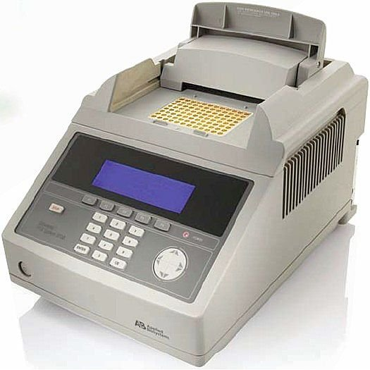
Temperature Programming
[Kao, Schweller, SODA 2006]: There is a constant set of tile types T such that, for every n, there is a sequence of temperature changes so that T assembles an n x n square.
Need ≈ log n temperature changes
temps = 3,2,5,3
temps = 3,2,4,5,3,2,4

Slide 62
Complexity of Temperature Programming
[Summers, Algorithmica to appear]: A fixed set of tile types can assemble any finite scaled shape through temperature programming.
Number of tile types (a self-assembly "resource") is constant, no matter the shape.
Other resource bounds:
What resolution loss is required?
What number of temperature changes are required?

Slide 63
Complexity of Temperature Programming
For shape S with n points, trade-off between resolution loss and number of temperature changes:
With optimal resolution loss = constant (22 in Scott's paper although shown smaller in the example), need ≈ n temperature changes.
With optimal number of temperature changes = size of smallest program p that prints S, resolution loss ≈ running time of p.
large # temp. changes
temps = 3,2,4,5,3,2,4
small resolution loss
large resolution loss
small # temp. changes
temps = 3,2,4

Slide 64
Concentration Programming
[Becker, Rapaport, Rémila, FSTTCS 2006]: Set relative concentrations of tile types to control what is likely to assemble.
singly-seeded set of tile types; blue and orange share glues so they compete
[ ] = 0.8
likely assemblies:
[ ] = 0.5
likely assemblies:
[ ] = 0.2
[ ] = 0.5
unlikely assemblies:
unlikely assemblies:

Slide 65
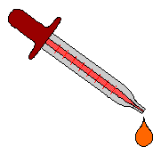
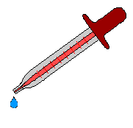
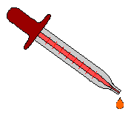


Concentration Programming for Approximate Shapes
[Kao, Schweller, ICALP 2008]: A fixed set of tile types can assemble, for any n, a square of width within 1% of n x n with probability at least 99%.

Slide 66
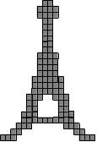
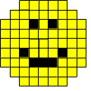

Concentration Programming for Exact Shapes
[D, SICOMP 2010]: A fixed set of tile types can assemble any n x n square with high probability by setting tile concentrations depending on n.
And, a fixed set of tile types can assemble any finite scaled shape with high probability through tile concentration programming; resolution loss depends on size of shape.

Slide 67

Randomized Self-Assembly with Equal Concentrations
[Chandran, Gopalkrishnan, Reif, ICALP 2009]: The tile complexity of assembling a line within 1% of length n is ≈ log n, if concentrations of all tile types are required to be equal.

Slide 68
Step Assembly
[Reif, DNA 3]: Step-assembly model:
  Assembly proceeds in stages.
  Only some tile types are present in stage n.
  They are all washed away before introducing a different subset of tile types in stage n+1.
Many problems can be solved with optimal assembly size and parallel time
  prefix sum (basis for parallel solutions to addition, multiplication by constant, finite automata simulation, etc.)
  shuffle-exchange networks (discrete Fourier transform, bitonic merge, etc.)

Slide 69
Step Assembly
[Manuch, Stacho, Stoll, Natural Computing to appear]: For a large class of shapes, including arbitrary shapes scaled by factor 2 or any other shape with a Hamiltonian path, a constant set of tile types can assemble the shape in the step assembly model.

Slide 70
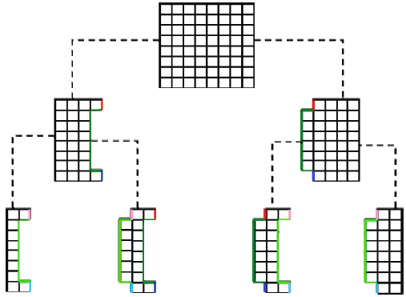
Staged Self-Assembly
[Demaine, Demaine, Fekete, Ishaque, Rafalin, Schweller, Souvaine, DNA 13]: Separate test tubes reach a terminal state before washing away tile types and being mixed.
Constant number of tile types can be used to assemble any shape
≈ log n (parallel) stages required for n x n square,1 x n line, monotone shapes

Slide 71
Staged Self-Assembly at DNA 17
[Demaine, Eisenstat, Ishaque, Winslow, DNA 17]
One-dimensional staged self-assembly of strings:
  Problem: design fixed tile set (each labeled with a symbol) so that, given any string of symbols x, tiles can be mixed to uniquely assemble a linear assembly “spelling” x.
  Question: How many mixing stages are required?
  Answer: If each tube must have unique terminal assembly, equal to size of smallest context-free grammar producing x. Otherwise, can sometimes use fewer mixing stages.

Slide 72
Hierarchical Self-Assembly

Slide 73
Hierarchical Self-Assembly
Overlap disallowed in attachment events (“steric protection”)

Slide 74
Shape-Building with Small Resolution Loss and Optimal Tile Complexity
program p that prints S
S =
[Demaine, Patitz, Schweller, Summers, STACS 2011]
With one step of adding RNase, given any finite shape S with n points, a (singly-seeded) tile set of same size as the smallest program that prints S (which is optimal), assembles S with resolution loss about log n.
growth
execute p
dissolve RNA
S = (1,2), (2,2), (3,2), (1,1), (3,1)
process each point of S into a block of DNA tiles designed to bind to its neighbors in S
(1,2)
(2,2)
(3,2)
(1,1)
(3,1)
RNA tiles:
DNA tiles:

Slide 75
Hierarchical Self-Assembly at DNA 17
[Patitz, Schweller, Summers, DNA 17]
Tile complexity of n x n squares 3D hierarchical temperature 1 is ≤ log n.
Recall in single-tile-aggregation 2D model:
  temperature 2: log n / log log n
  temperature 1: conjectured 2n-1
  temperature 1, no glue mismatches: proven 2n-1 [Manuch, Stacho, Stoll 2009]

Slide 76
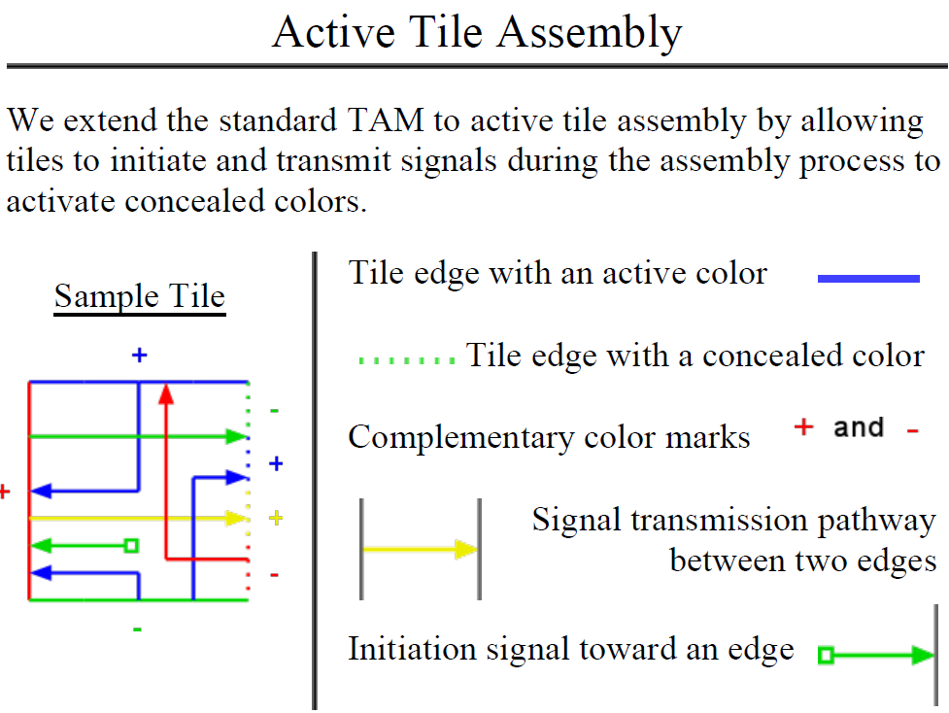
Hierarchical Self-Assembly at DNA 17
[Karpenko, Jonoska, Padilla, Liu, Seeman, DNA 17]

Slide 77
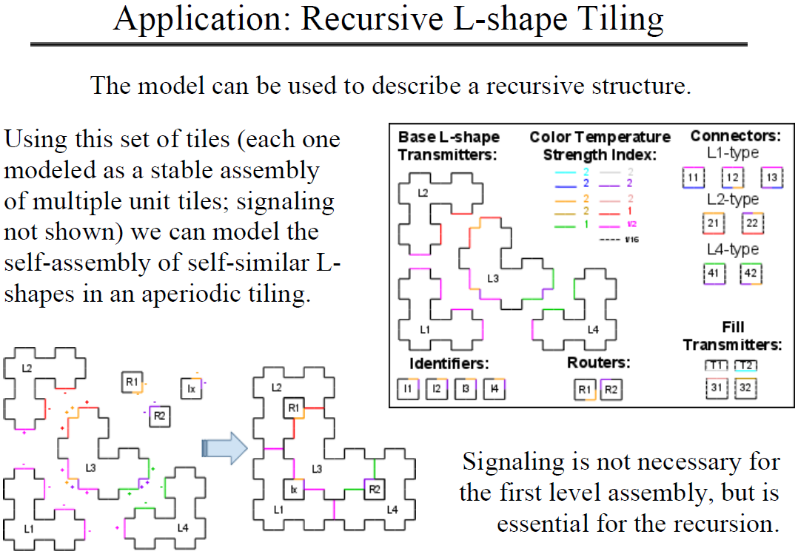
Hierarchical Self-Assembly at DNA 17

Slide 78
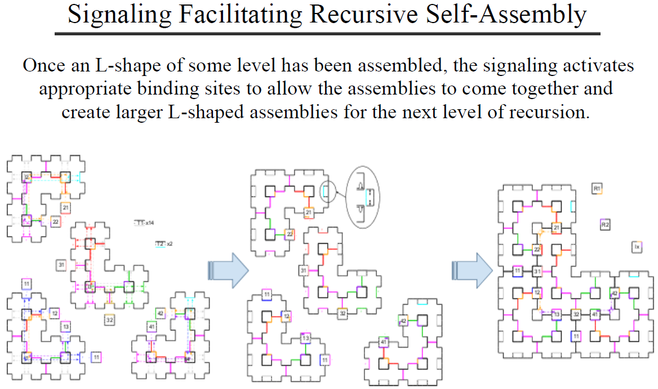
Hierarchical Self-Assembly at DNA 17

Slide 79
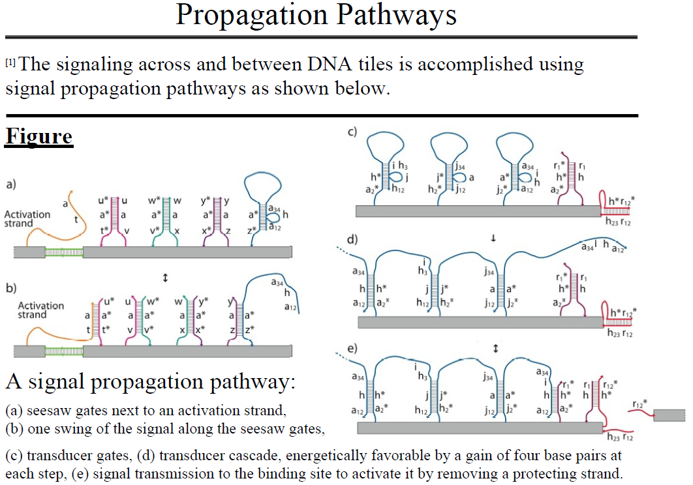
Hierarchical Self-Assembly at DNA 17

Slide 80



Thank you!

